Slide 1

Prediction of Chronic Kidney Disease using Support Vector Machine and Neural Network
Guided by, Submitted by,
Mrs.S.Kamakshi Vydana Sindhu 120003374 APIII-CSE/Soc Sriram Sindhura 120003309

Slide 2
Base Paper Information
Title :
Neural network and support vector machine for the prediction of chronic kidney disease
Source :
https://www.sciencedirect.com/science/article/pii/S0010482519301258#bib26
Author :
Njoud Abdullah Almansour, Hajra Fahim Syed
Year of Publication:
2019

Slide 3
Outline
Introduction
Problem Statement
System Model
Data Preprocessing
Algorithms Implementation
Performance Analysis
References

Slide 4

Introduction
10,203 patients diagnosed with kidney disease receive hemo dialysis by study of Saudi Center of Organ Transplantation Registry
Diabetes, high blood pressure, and unhealthy lifestyles have led to an increase in the number of patients with Chronic Kidney Disease(CKD)

Slide 5
Introduction
Patients with CKD suﬀer from various side eﬀects and complications that include damage to the nervous and immune systems that disrupt daily activities
To assist in the prevention of CKD, machine learning techniques can be utilized to diagnose CKD at an early stage

Slide 6
Introduction
Artiﬁcial Neural Network (ANN) and Support Vector Machine (SVM) are widely used machine learning techniques in recent times
ANN : A mathematical model that acts similar to human neurons
SVM : A computational algorithm that can learn from experience and examples to allocate labels to objects

Slide 7
Problem Statement
To assist in the prevention of Chronic Kidney Disease (CKD) by utilizing machine learning techniques to diagnose CKD at an early stage

Slide 8
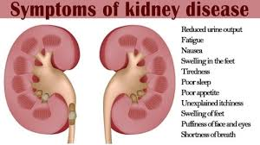
Figure 1

Slide 9
Modules
Data Cleaning
Data Preprocessing
Application of algorithms
Prediction of CKD disease
Performance analysis

Slide 10
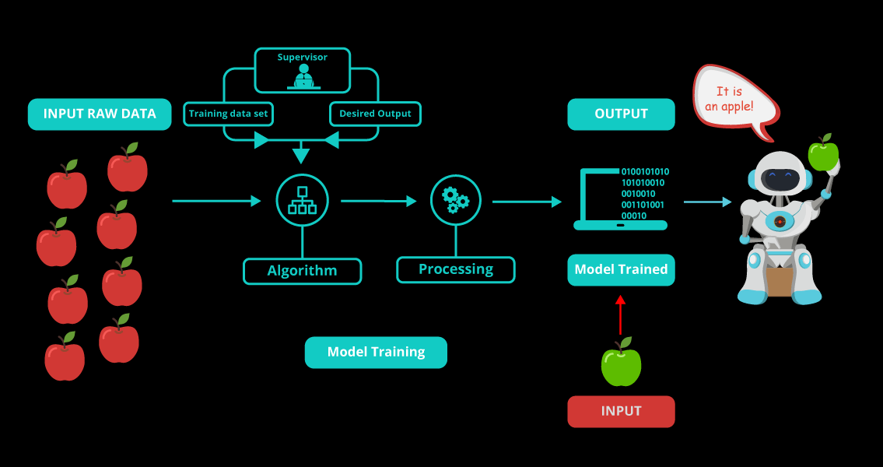
System Model
Figure 2
Notes:
Model

Slide 11
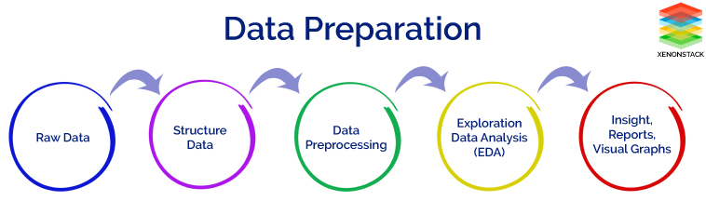
System Model
Figure 3

Slide 12
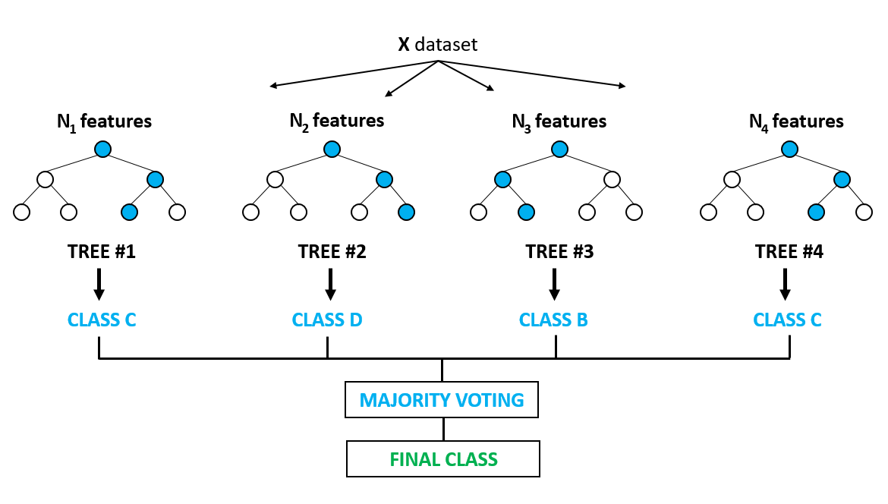
System Model
Figure 4

Slide 13
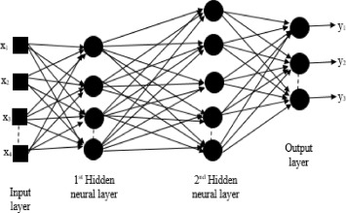
System Model
Figure 5

Slide 14
Algorithms
Support Vector Classification
Random Forest Classification
Naïve Bayes Classification
K nearest Neighbors Classification
Artificial Neural Networks
Multilayer perceptron (MLP)

Slide 15
Proposed System
Naive Bayes,K-Nearest Neighbor (KNN), tree-based decision, and random subspace classiﬁcation algorithms can be used to predict occurrence of CKD in patients
All regression algorithms will be applied
Results of different algorithms will be combined.
According to the accuracy weighted mean will be taken to find the result
Evaluation metrics: accuracy, precision, sensitivity, specificity and F1 score

Slide 16
Data Preprocessing and Feature Scaling
Missing Data in numerical columns is replaced with Mean
Missing Data in categorical columns is replaced with a global value ‘nun’
Categorical values are converted into numerical using the packages LabelEncoder and OneHotEncoder
Encoding is done separately for dependent and independent variables

Slide 17
Data Preprocessing and Feature Scaling
Data is divided into training set and test set in ratio 4:1
Cross Validation can also be used for splitting training and test set data
Feature Scaling is done using StandardScaler Package

Slide 18
Random Forest Classification(RFC)
Random forest, like its name implies, consists of a large number of individual decision trees
It is a Supervised Machine Learning Algorithm for Classification
Each individual tree in the random forest spits out a class prediction and the class with the most votes becomes our model’s prediction
In general, the more trees in the forest the more robust the forest looks like. In the same way in the random forest classifier, the higher the number of trees in the forest gives the high accuracy results

Slide 19
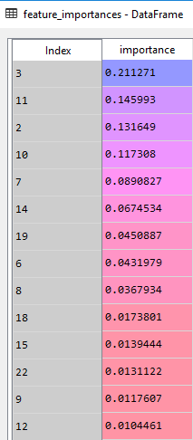
Feature Importance in RFC

Slide 20
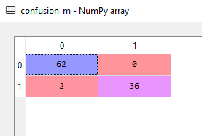
Performance Analysis of RFC
Confusion matrix and accuracy score are computed
Time Complexity : O( v * n log(n) ), where n is the number of records and v is the number of variables/attributes
Execution time : 0.01958 sec

Slide 21
Implementation of SVM
“Support Vector Machine” (SVM) is a supervised machine learning algorithm
In this , we plot each data item as a point in n-dimensional space (where n is number of features you have) with the value of each feature being the value of a particular coordinate
Then, we perform classification by finding the hyper-plane that differentiate the two classes very well (look at the below snapshot)

Slide 22
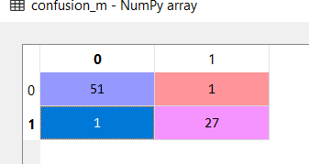
Performance Analysis of SVM
Confusion matrix and accuracy score are computed
Accuracy obtained in SVM is 97.5%
Time Complexity : O(nSVd) where nSV is the number of support vectors and d is no. of input dimensions
Execution time : 0.02254 sec

Slide 23
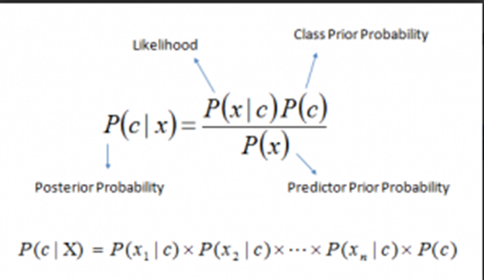
Naive Bayes Classification(NB)
A classification technique based on Bayes' Theorem with an assumption of independence among predictors.
It’s NAIVE as it assumes that features of a measurement are independent of each other

Slide 24
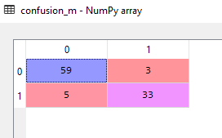
Implementation of Naive Bayes
Posteriori Probability is based on likelihood measures of data getting into a particular class
Accuracy obtained for this model is 92%
Confusion Matrix for this model is given below:

Slide 25

Results for Naive Bayes
Classification report for Naive Bayes:
Execution time : 0.1163 sec
Time complexity : O(Nd) for d features

Slide 26
K Nearest Neighbours(KNN)
Classifies the data based on distance measures such as Manhatton or Euclidean or Minkowski
No. of neighbours K decides the class to which the new data point belongs to
Cross validation can also be used to find out optimal K value
Minkowski with Power parameter 1 acts as Manhatton
Minkowski with Power parameter 2 acts as Euclidean

Slide 27
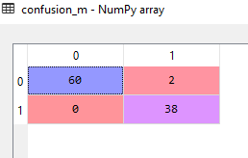
Implementation of KNN
Accuracy for this model is 98%
Confusion matrix for this model is:

Slide 28

Results for KNN
Classification report for KNN
Execution time : 0.0494 sec
Time complexity : O(logN) –average O(kN^(1-1/k))-worst

Slide 29
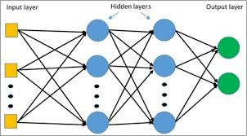
Multi Layer Perceptron

Slide 30
Multi Layer Perceptron(MLP)
A class of feedforward artificial neural network consisting of at least three layers of nodes: an input layer, a hidden layer and an output layer
A neural network y=f(x;θ) is called feedforward as it goes from x to y in forward direction where x is input layer and y is ouput layer
Input layer to receive the signal
Output layer that makes a decision or prediction
Hidden layers that are the true computational engine of the MLP

Slide 31
Results for MLP
Confusion matrix
Accuracy-0.98
precision recall f1-score support
0 0.97 1.00 0.98 62
1 1.00 0.95 0.97 38
avg / total 0.98 0.98 0.98 100
Execution time : 0.1596 sec
Time complexity : O(n^2)
 | Predicted CKD | Predicted Not CKD
Actual CKD | 60 | 0
Actual Not CKD | 2 | 36

Slide 32
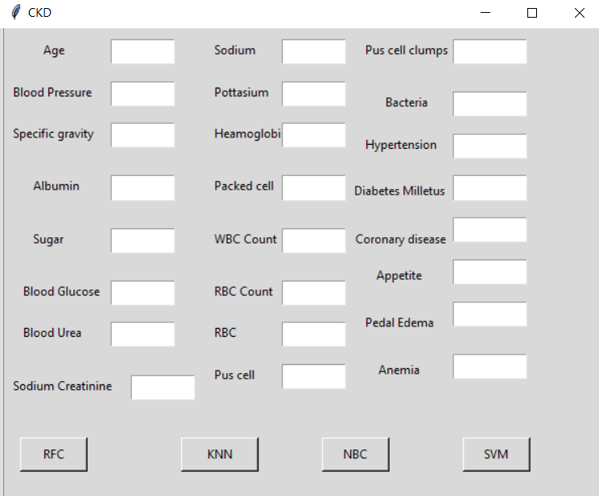
GUI

Slide 33
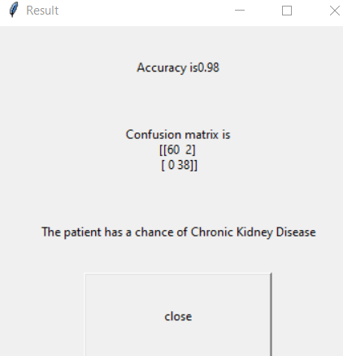
GUI

Slide 34
Conclusion
Random forest classifier yielded better results
Based on the feature importance the symptoms which are fatal can be known and pre care can be taken to avoid CKD(Chronic Kidney Disease)
MLP has less complexity and gives good accuracy
MLP can be used for huge datasets and the accuracy wouldn’t decrease

Slide 35
References
[1] F. Lombardi, T.H. Mäkikallio, R.J. Myerburg, H.V. Huikuri, “Sudden cardiac death: role of heart rate variability to identify patients at risk”, Cardiovasc. Res., 50 (2) (2001), pp. 210-217.
[2]Z. Chen, X. Zhang, Z. Zhang,”Clinical risk assessment of patients with chronic kidney disease by using clinical data and multivariate models”,Int. Urol. Nephrol., 48 (12) (2016), pp. 2069-2075
[3] A. a Al-Sayyari, F. a. Shaheen,”End-stage chronic kidney disease in Saudi Arabia. A rapidly changing scene”,Saudi Med. J., 32 (2011), pp. 339-346
[4] A. Survey, Importance of artiﬁcial neural networks for location of faults in transmission systems, Surveyor (2017) 357–362.
[5] T.S. Furey, N. Cristianini, N. Duﬀy, D.W. Bednarski, M. Schummer, D. Haussler, Support vector machine classiﬁcation and validation of cancer tissue samples using microarray expression data, 16 (10) (2000) 906–914.
[6] A.A.A.A. Adewumi, T.O. Owolabi, I.O.I.O. Alade, S.O.S.O. Olatunji, Estimation of physical, mechanical and hydrological properties of permeable concrete using computational intelligence approach, Appl. Soft Comput. 42 (2016) 342–350
[7] K.O. Akande, S.O. Olatunji, T.O. Owolabi, A. AbdulRaheem, Feature SelectionBased ANNfor Improved Characterization of Carbonate Reservoir, CPAPER, Society of Petroleum Engineers, 2015, http://doi.org/10.2118/178029-MS.
[8] C. Cortes, V. Vapnik, Support-vector networks, Mach. Learn. 297 (1995) 273–297.
[9] M.M. Luck, A. Yartseva, G. Bertho, E. Thervet, P. Beaune, N. Pallet, Metabolic proﬁling of H-1 NMR spectra in Chronic Kidney Disease with local predictive modeling, 2015 IEEE 14th International Conference on Machine Learning and Applications (Icmla), 2015, pp. 176–181 http://doi.org/10.1109/icmla.2015.155.
[10] A.M. Al-Taee, A.Y. Al-Hyari, M.A. Al-Taee, Clinical decision support system for diagnosis and management of chronic renal failure, 2013 IEEE Jordan Conference on Applied Electrical Engineering and Computing Technologies (AEECT), 2013.
[11] R. Ani, G. Sasi, R.S. U, O.S. Deepa, Decision support system for diagnosis and prediction of chronic renal failure using random subspace classiﬁcation, 2016 International Conference on Advances in Computing, Communications and Informatics (ICACCI), 2016, pp. 1287–1292 http://doi.org/10.1109/ICACCI.2016. 7732224.

Slide 36


